Slide 1
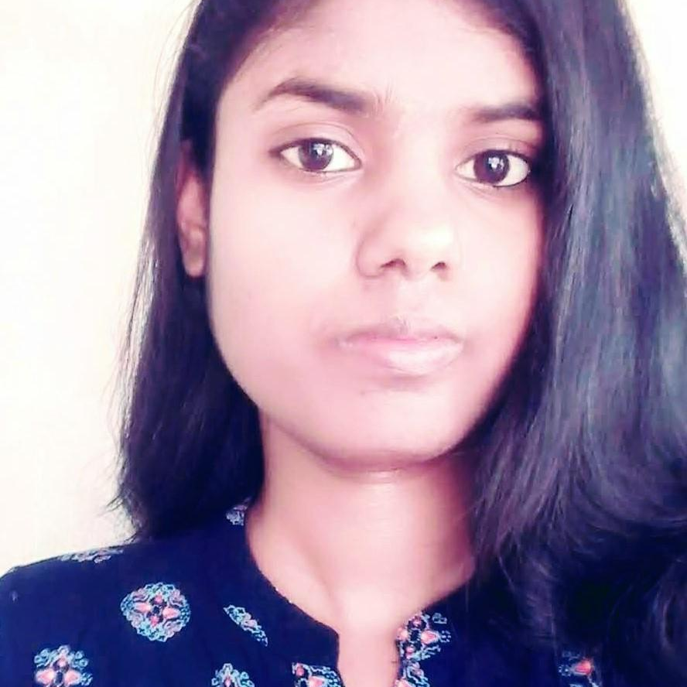



MOUNIKA YEDLA
Analyst/Software Engineer
Bachelor of Technology
Computer Science : 2015 – 2019
Certifications:
Full stack Developing - Edubridge-2021
Skills Java 8 /J2EE
Spring Boot
Spring MVC
MERN Stack
NodeJS
MongoDB
Database
SQL database – MySQL
No SQL database – MongoDB
Web Technologies
HTML5
CSS3
Javascript
AddOns
Github
Maven
Postman
Additional Details
Leadership
Quick Learner
Team management
Time management
Bangalore
Yedla.mounika@capgemini.com
7036161386
A4
Software Engineer who is Strong in design and integration with intuitive problem-solving skills. Passionate about implementing and launching new projects.
Ready to learn new technologies and implement them to further improve my knowledge.
Eager to work in a team of dedicated people and serve a key role in the enhancement and development of the project.
Has working knowledge on Angular and Java Microservice Development using Spring framework on an intermediate level.
https://github.com/mounikayedla
Hotel Management System
Completed end to end case study of Hotel Management Application along with JWT authentication, Swagger and payment, testing using Microservices and Spring Boot. Material-UI and Angular used for user interface.
HTML CSS JAVASCRIPT for web developers at Coursera
Completed this course with 98.6% and Designed responsive Restaurant website using HTML5 CSS3 Bootstrap and Javascript
Check out my work on GitHub & Video Profile

